Slide 1
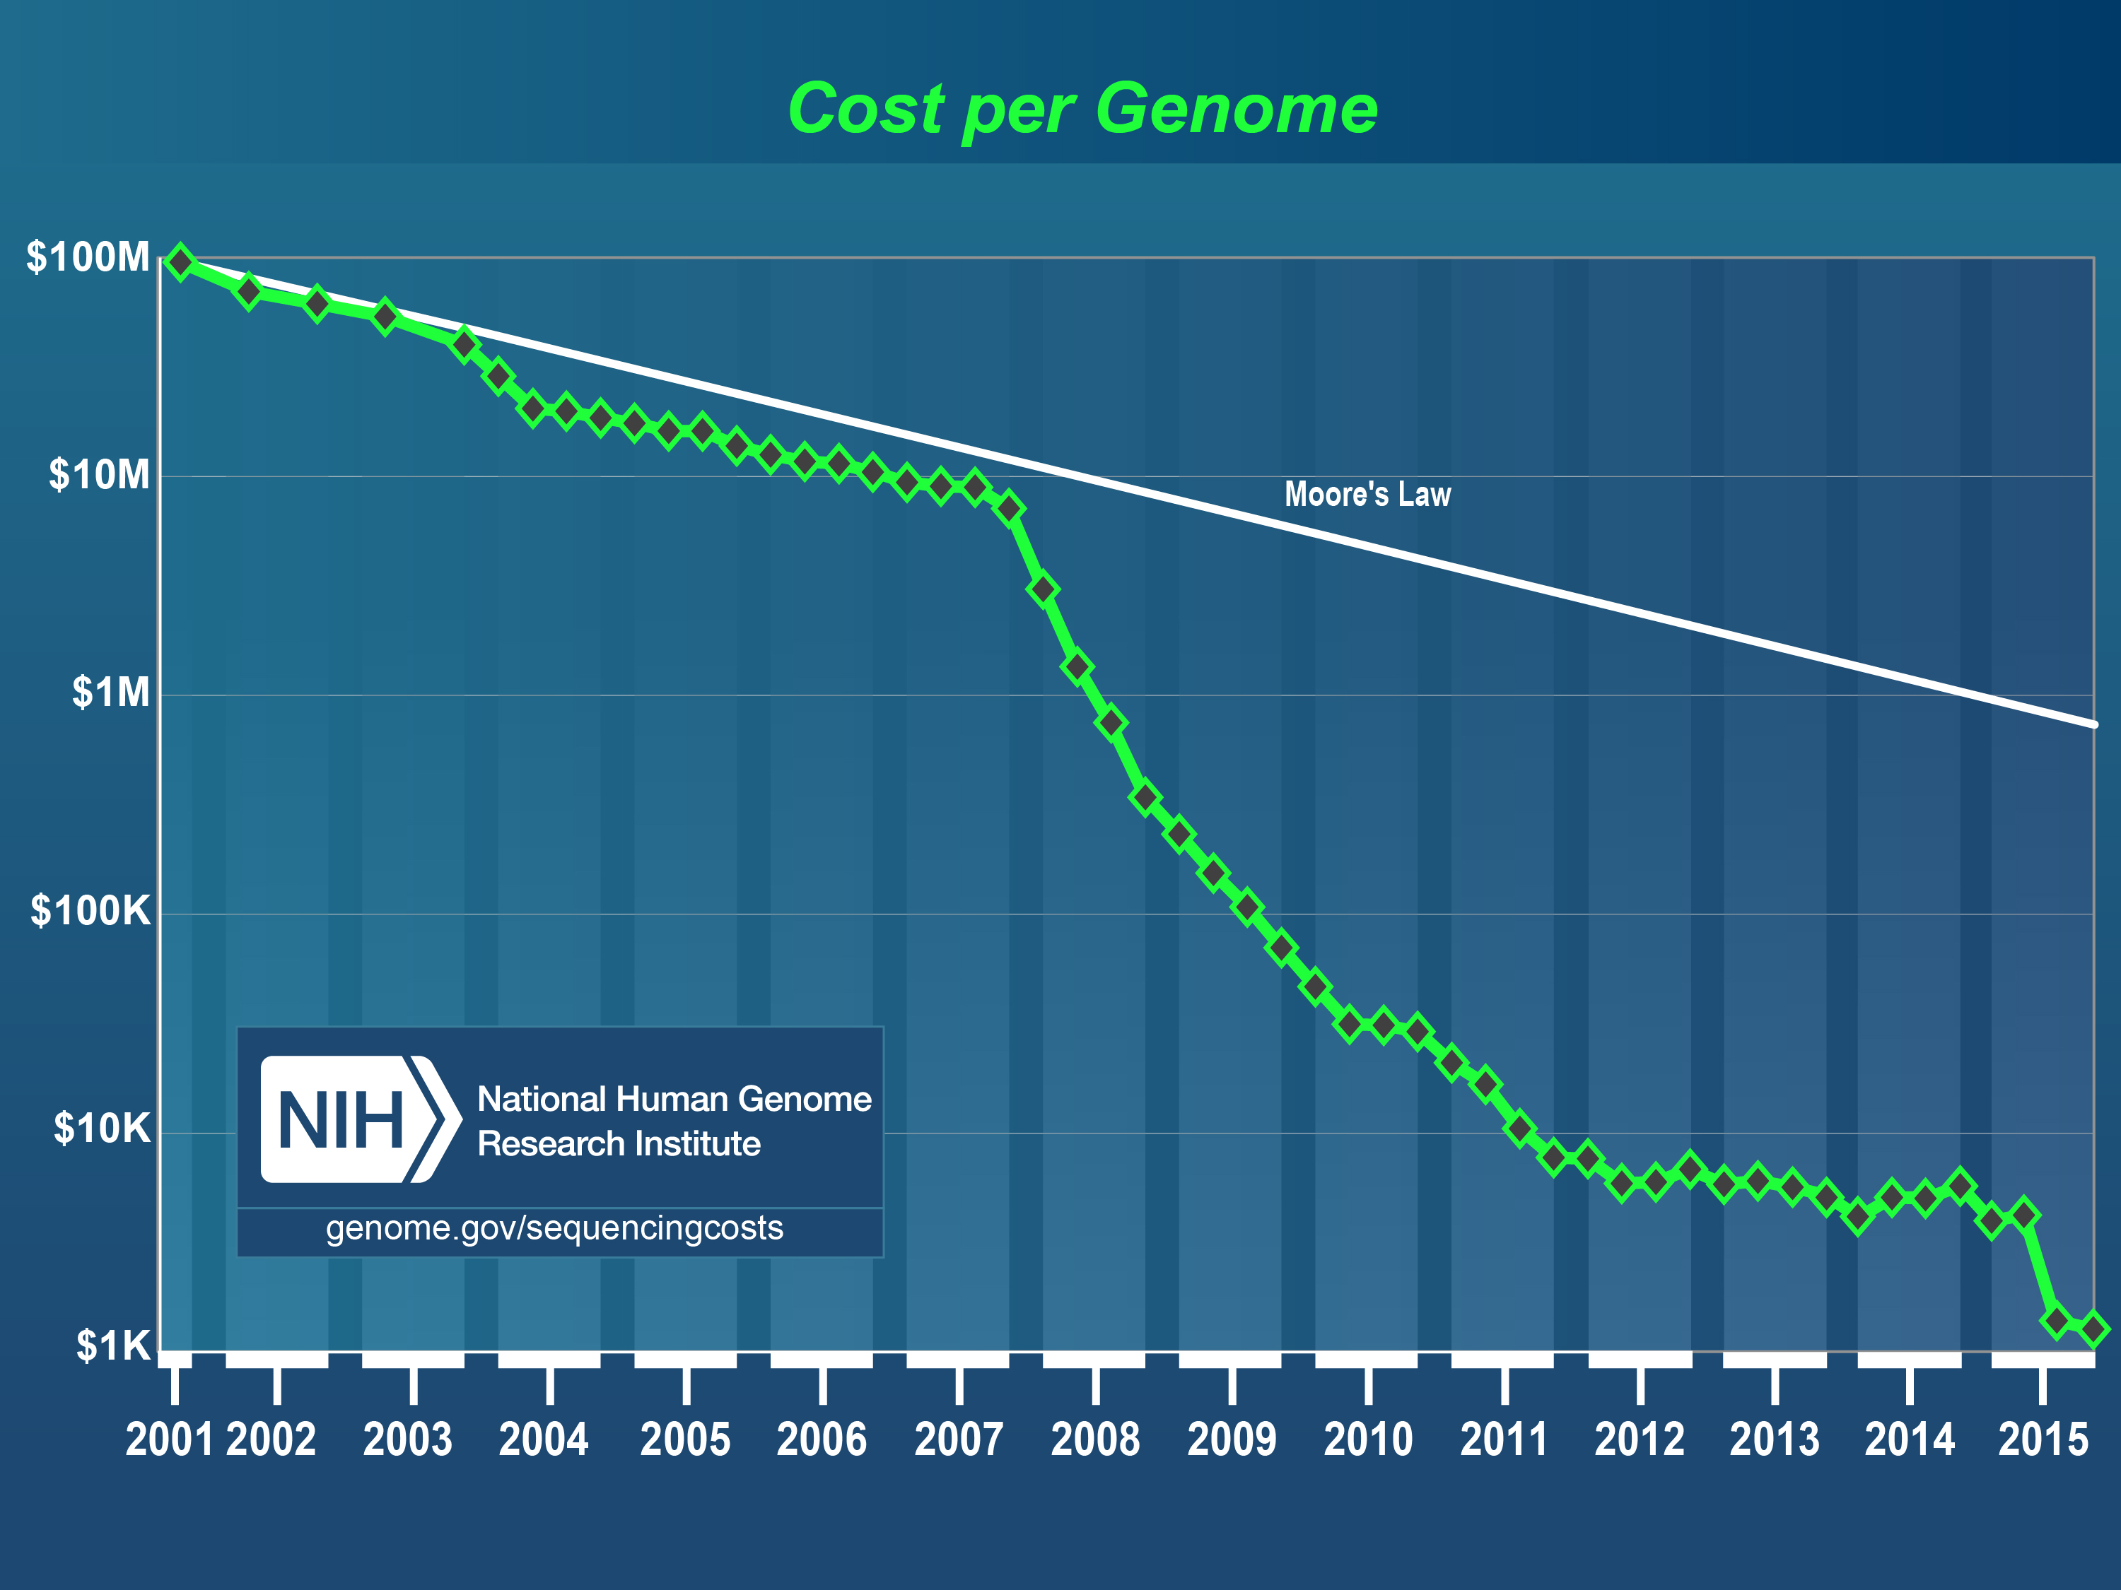
Where did the data we were looking at come from?
Next generation sequencing
Notes:
Next generation sequencing is a term we use to describe the latest DNA sequencing technology, which has been around since around 2007. We call it NGS or next generation sequencing.

Slide 2
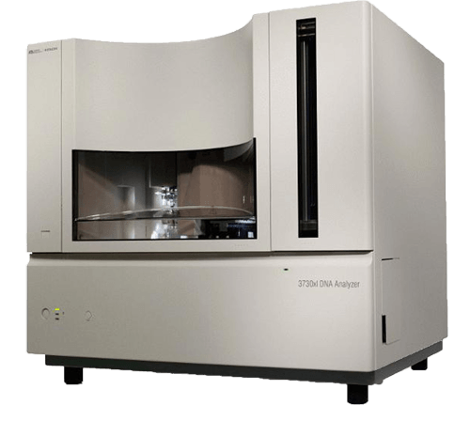
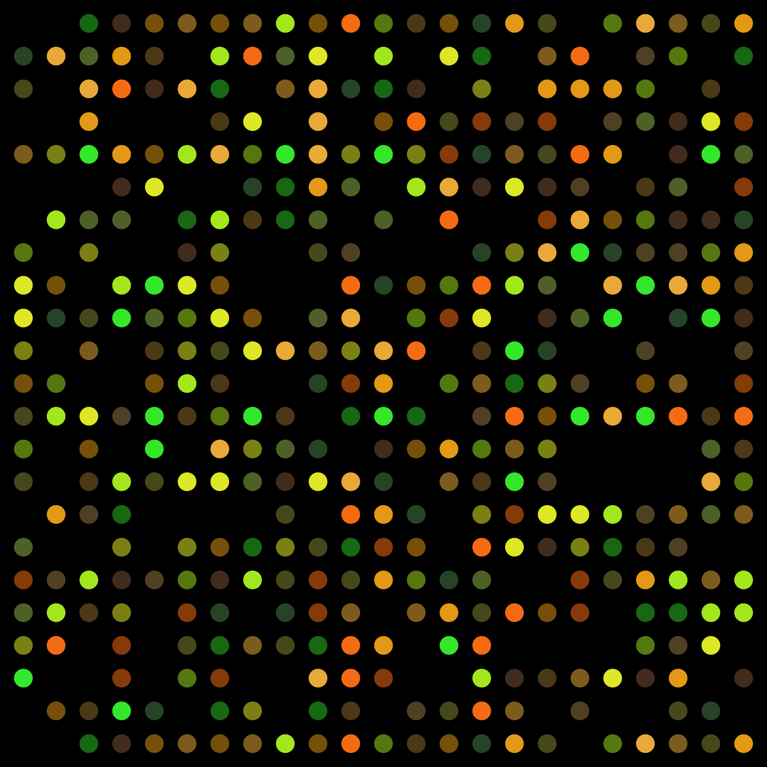
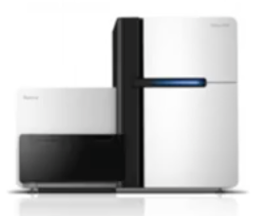
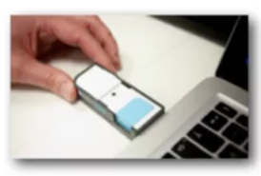
A history of Sequencing
Sanger DNA sequencing
DNA Microarrays
2nd generation
DNA sequencing
3rd generation DNA sequencing
and single molecule sequencing

Slide 3
PCR – polymerase chain reaction
Amplifies portion of DNA
Used in all next gen seq
Notes:
all these DNA sequencing technologies rely on taking a DNA template, the DNA that you want to sequence and copy. The molecular machinery that, that cells use for copying is a key tool in this process. So DNA, it's copied by a molecule called DNA Polymerase which takes free nucleotides, those are As, Cs, Gs and Ts, that are just floating around in your cell or you can synthesize them so that they can be floating around in your test tube. And it uses them to copy the DNA that you're trying to sequence. And of course when we copy, we use this rule of DNA that gGs always bind to Cs and As always bind to Ts. So, you start with single strand DNA, and then with, you add lots of As, Gs, Cs, and Ts, and some DNA preliminaries and you can synthesize the, the complimentary strand. Now if you could just watch this happening, then you wouldn't need to do what we're calling sequencing. Somehow you get to observe this and measure your DNA while all this is going on.

Slide 4
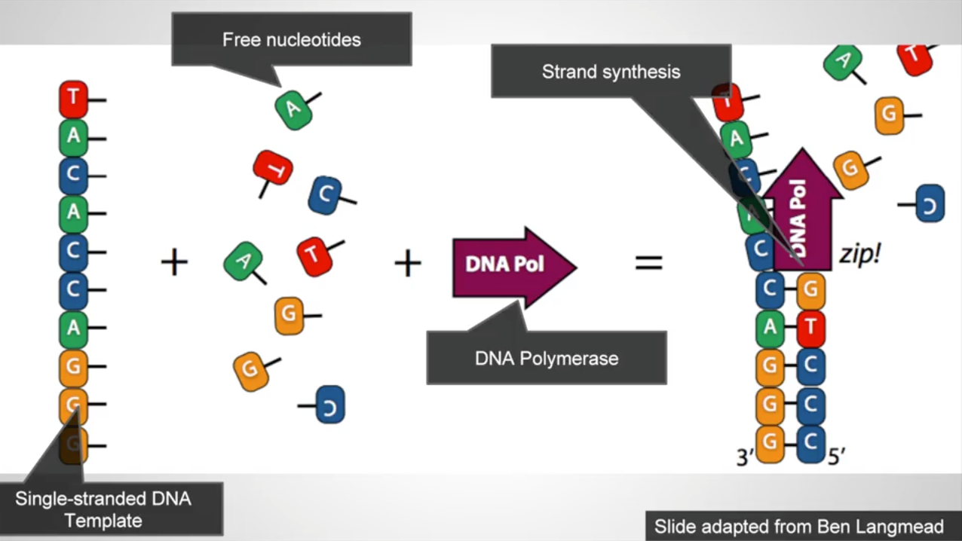

Slide 5
Next generation sequencing (NGS)
Sequencing by synthesis

Slide 6
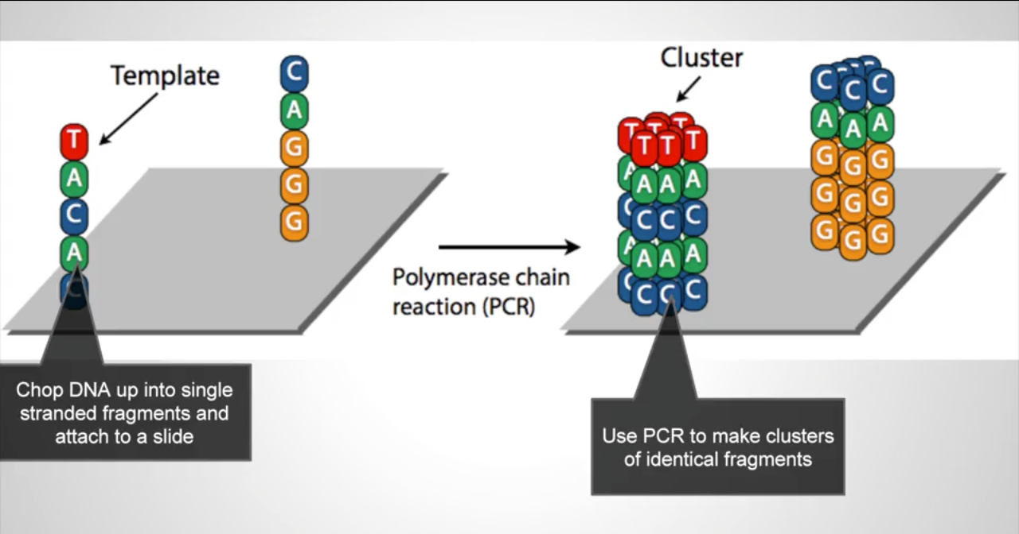
Notes:
we take our, our template DNA, we chop it up into small pieces. Typically a few hundred bases long, maybe a little longer than that maybe as much as 1,000 bases long and we attach those, we chemically attach those to a slide. Now, on the slide, there'll be millions or tens of millions of these, of these fragments of DNA .
Then on the slide itself we use polymerase chain reaction or PCR to make many identical copies of those pieces. So then you get these little clusters that you're seeing here where you have a cluster of fragments that might in fact be a few million copies but it's a relatively small number, a few million, copies of these very short fragments DNA. And they're all single stranded and they're all stuck to these spots on a slide. So now you still have them sequencing, you just made copies of these fragments. You still don't have any idea what's on the slide. You need to read it off somehow.

Slide 7
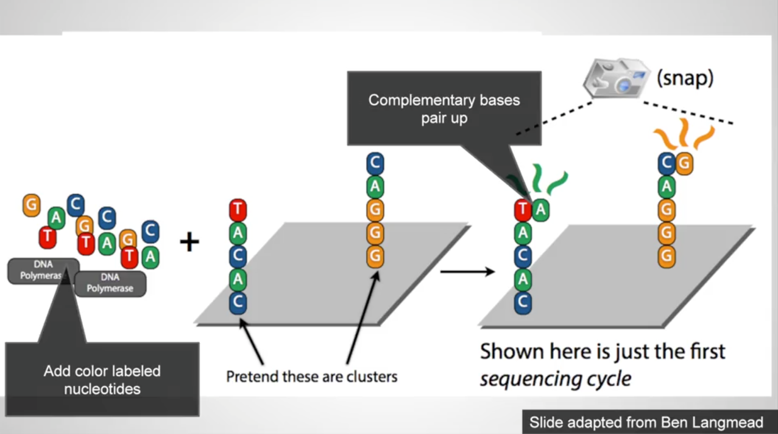
Notes:
use again, the, the, the property that DNA when it's copying. Single strand of DNA will always use the complementary base. So we can mix in we can add to the slide some nucleotides, As, Cs, Gs, and Ts. That are labeled with a, with in a special ways so that we hit them with the light with a laser, they'll, they'll, fluoresce in four different colors. So we get, if we hit, say the Ts here, with the light, they'll, they'll fluoresce in red, and we'll know that, that we've looked at a T. So what we want to do is we want to add these to the slide, and have them hybridized or base pair with the single stranded templates that we, that we have on the slide.
a very important property of Next Generation Sequencing is that these nucleotides that we're adding are specially modified in, in two different ways. One thing that, that happens is that they fluoresce. So each of them has, each of the four nucleotides is a different color that fluoresce it. But another very important property and this was a very clever invention is that they have a terminator modification. That is once you've added the DNA polymerase which is, which is attaching them to these templates. Once it's added one of these molecules, it can't add another one. It can only add one because they're chemically modified to have a terminator. However, it's a reversible modification. So after we take our picture, we can remove the modification and let the polymerase go on and add the next base .
what these next gen sequencers do is, in parallel, at millions of spots on the slide, we add a single base to that, to that spot. And every spot because it has a different template may have a different base added. Then, we just take a picture. And the way we take a picture is we shine a light while we're imaging the slide and that shows us at every spot what color is what color is the base that's, that's just been added to that template.

Slide 8
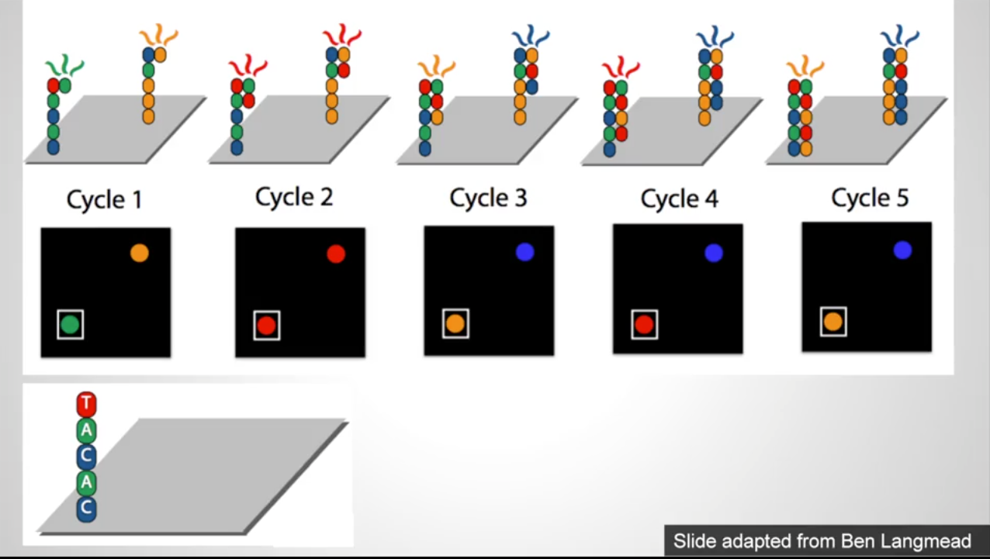

Slide 9
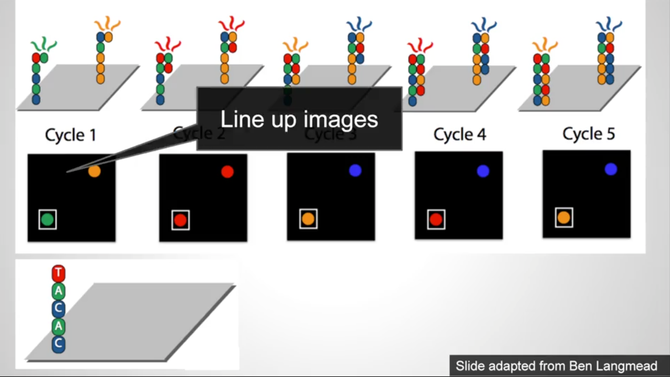

Slide 10
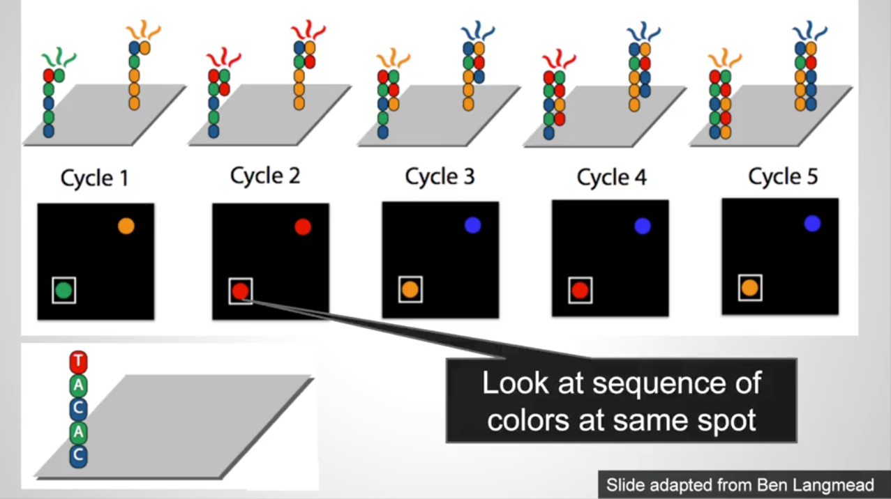

Slide 11
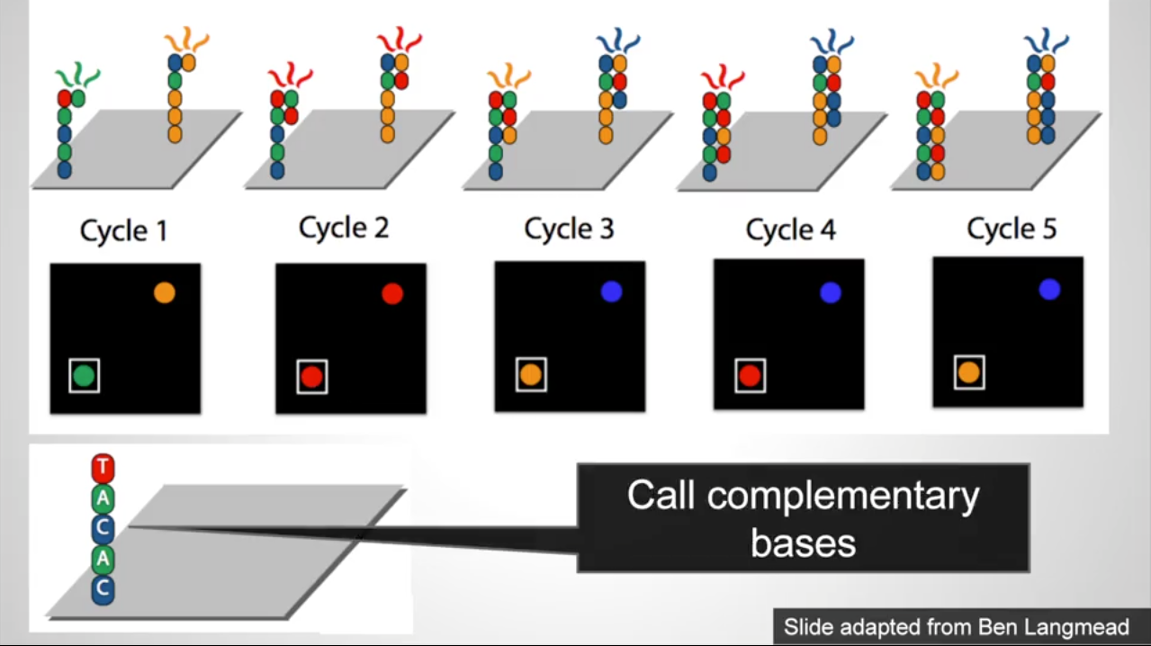
Notes:
what happens is we go through these sort of cycles of sequencing? In each cycle, we will, we will sequence another base. We'll add one more base to the template strand that we're to the new strand that we're synthesizing from the template. So, we'll get pictures like what you're seeing here for cycles one through five where every picture we need to register these pictures so they're all lined up. And if we just look at the, at the spot in the lower left, we'll see okay it's green and then maybe in the second cycle it might be red and, and so on. And as we go through the cycles, we can call the bases because the colors tell us what those bases are. So we, we, at each spot on the slide, we're reading a different sequence off, and we read all of them, of course, in parallel, all sequences that are attached to this slide in parallel. And with face technology that there will be millions of these short fragments attached to the same slide. So when we're done, we'll have millions of sequences all of once.

Slide 12
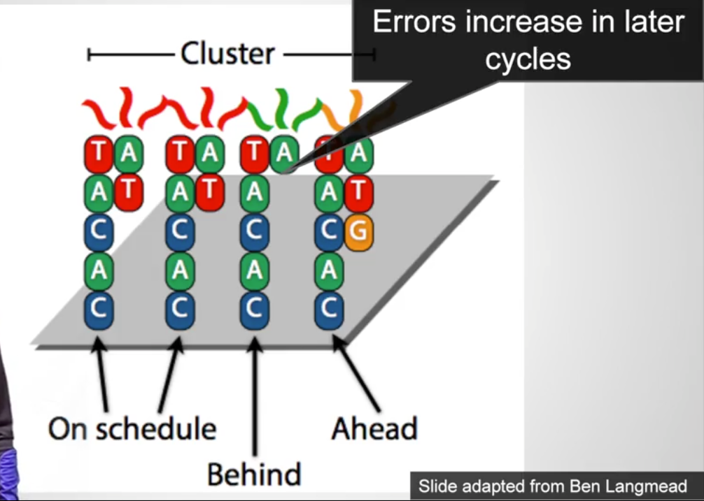
Notes:
an important the reason you need to understand this, and understand this data. Is that there are errors in it. So there are a number of sources of error. One source is that, one, one property is that errors increase in later cycles. And the reason this happens is that, remember we're making millions of a few million copies of identical copies in, in one of these clusters, and we're sequencing that cluster one base at a time. Well, this property of DNA polymerase adding a base isn't perfect. So the DNA polymerase, we hope, will add a single base to every fragment on that, in the little cluster in one cycle. But once in awhile, it'll add an extra fra, it'll add an extra base, and that, that fragment will get ahead. And once in awhile it'll fail to add a base, and that fragment will get behind. So what that means is that instead of having all these molecules show as the same color, a few of them, at first a very tiny number, will have the wrong color when we hit it with a light. But as time goes on the number of these fragments and these little template strands that are out of sync will increase. And that increases your error. So that's why we can't just read thousands of bases using this technology. Because eventually the error is too great and we can't read the sequence accurately.
So at the end when you get from the, the read out you get from this, this process is, and every position on this slide, every spot you get a read. And a read is just a long streak sequence of, of As, Cs, Gs and Ts, and here's one of the formats we commonly see it in. And, associative with every one of those As, Cs, Gs and Ts is a quality value. Which is an estimate by the base calling software is estimating how, how likely it is that there's an error at that point. And, it does that by trying to compute with, how pure that color signal was. And as, as the sequence goes on, that, that color isn't quite as pure, and the base calling software can tell that. And so it'll get, it'll tell you what its best guess of the base is, but it'll have a higher likelihood of error so the quality will go down.

Slide 13
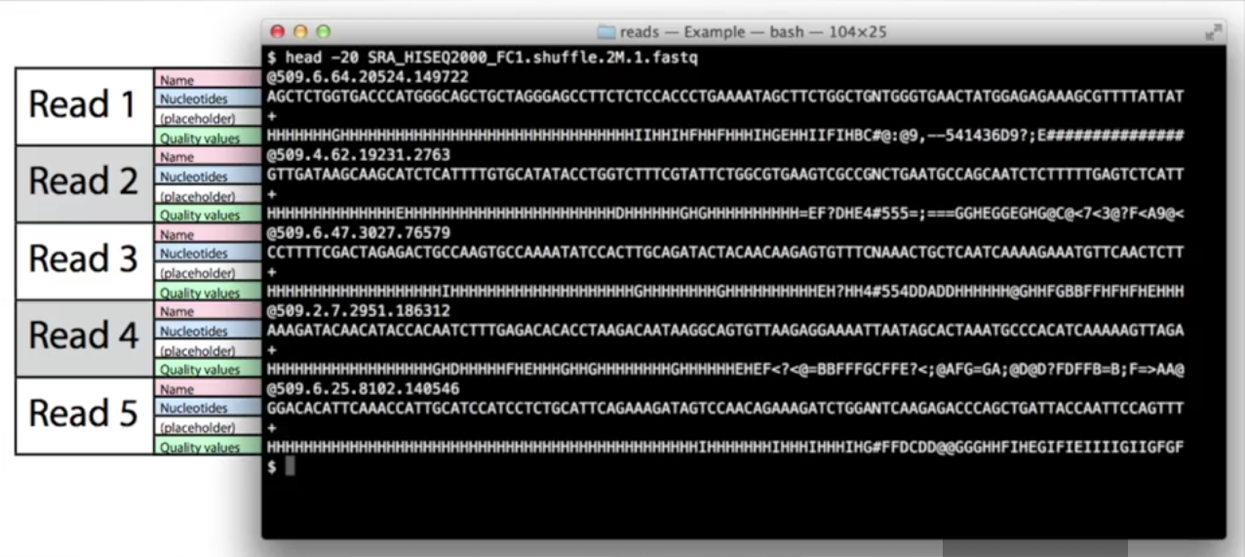

Slide 14
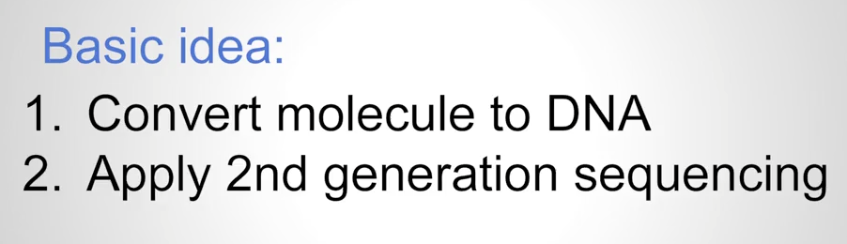
What can we use NGS for?
Notes:
The introduction of next generation sequencing technology, which has made sequencing so fast and so cheap, has allowed scientists to come up with all sorts of creative new types of experiments that they can use sequencing to do. So, another way to think about it is that we can now ask scientific questions and answer them with sequencing. Questions, that we've, we've had for decades in many cases, but sequencing was simply too expensive or too slow to answer them before. Well, today through next generation sequencing applications, and through some clever new experimental methodologies, we can answer all kinds of interesting questions using sequencing alone. So let's, let's look at some of those some of those methods right now. So the basic idea is we need to create DNA, because if we're going to sequence it, we need DNA. To convert a molecule into DNA, we might start DNA and just sequence it or we might start with RNA and convert it to DNA and sequence it. And then apply second generation sequencing to measure something.

Slide 15
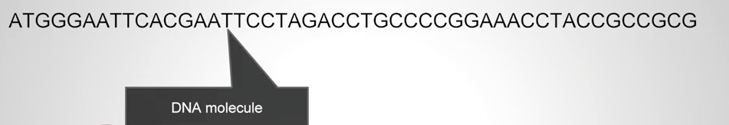
Exome Sequencing
Notes:
one very, very popular application today is exome sequencing. So, whats the exome? The exome is the collection of all the exons in your genome. So, what are exons? We've talked about that in other lectures, but let me just quickly review. Your DNA gets transcribed into RNA. And the RNA then gets chopped up into exons and introns. The introns get thrown away, the exons that remain are concatenated together, and those exons then get translated into proteins. So if you want to know what the proteins are that are being turned on in a cell that are, that are in a, in a collection of cells, you need to know what the exons are. So, in particular, in the world of genetics, when we're looking for genetic mutations, we're mostly, we're mostly interested, or usually interested first in, in mutations that affect proteins. So, those mutations should occur in exons. So, we can capture just the exons in a cell and sequence those. And you might say, well, why would we do that, we can sequence the whole genome? Well the exons only comprise about 1.5% of your genome. So you can sequence much less DNA and still get a picture of your entire exon, your entire exome.

Slide 16
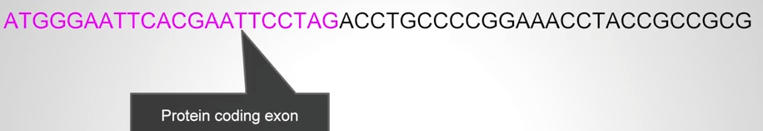
Exome Sequencing
Notes:
So how do we do that? We take the DNA molecule, so only some parts of the DNA like I said about a 1.5% of your genome or maybe on the order of 30 to 60 million bases will be captured as exons. And there are kits that do this. They will, they will capture this for you.

Slide 17
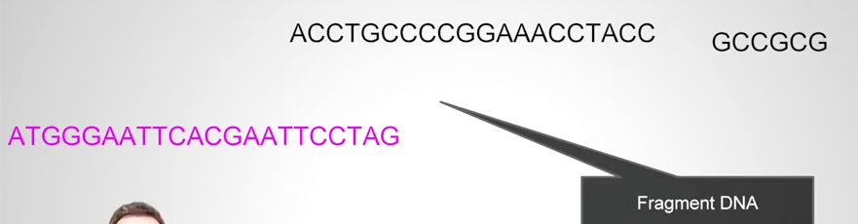
Exome Sequencing
Notes:
So we want to take that, that protein coding exon, you want to fragment your DNA, the whole genome, whole genomic DNA from a person whose exome we're sequencing and some of that will be exons and fragments of exons and some of it won't.

Slide 18
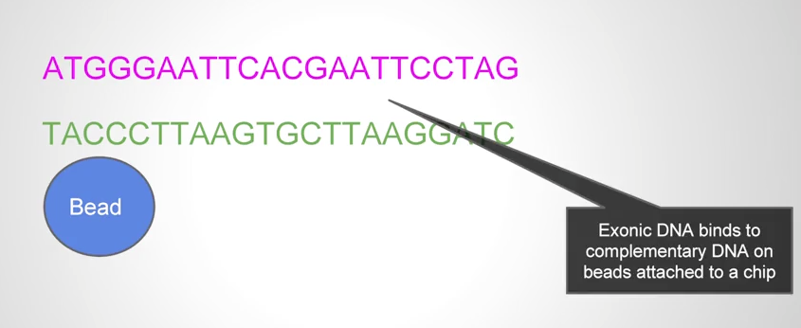
Exome Sequencing
Notes:
we want to just capture the exons. And so the kits that have been developed are kits where you have a a bead, a magnetic bead, typically. And on that bead you'll have pieces of DNA that are only found in exons attached, and this is single stranded DNA.
When you're preparing your DNA for sequencing you make it single stranded by heating it up a little bit. And then the, the DNA that belongs to exons will hybridize to the complementary DNA that's attached to those chips.

Slide 19
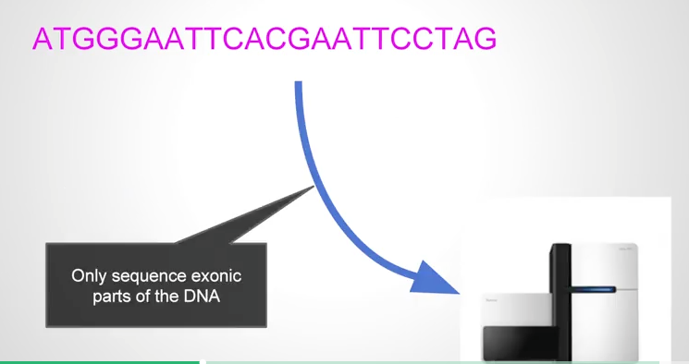
Exome Sequencing
Notes:
And then you can pull those chips down, and then remove the active of DNA attached to them, and sequence it. And that way you just have sequenced he exons. So that's exome sequencing, you only sequence the exonic parts of DNA, and kids today will capture around the order of 50 to 60 million base pairs out of a person's genome when they're doing exome sequencing.

Slide 20

RNA Sequencing
Notes:
Another technology is RNA-seq, or RNA sequencing. So, this, this involves trying to capture all the genes that are being turned on in a cell, or in a collection of cells. So as I just said, to, to produce a protein, DNA first gets transcribed into RNA, and then translated into proteins. So if we can capture the RNA, that gives us a picture of which genes are being expressed or turned on, in a particular cells, set of cells or cell type.

Slide 21
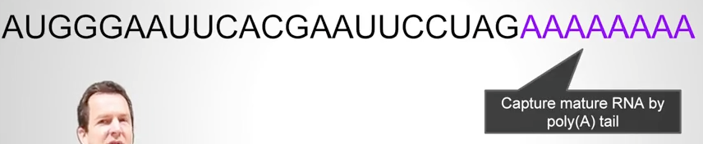
RNA Sequencing
Notes:
So a very important feature of the RNA molecule, is that after transcription, the cell attaches a long string of A's to it. So we can use that, and that's sort of the basis of RNA-seq technology is that all the molecules that we're interested in have these long stretches of A's on the end. Anything that doesn't have a long stretch of A's we can ignore.
So we capture that poly A tail by various techniques. Basically, we use a string of T's that we know will stick to all those A's. And we, we, attach those T's to something we can grab a hold of, and through that we capture the mature mRNA by it's poly A tail.

Slide 22
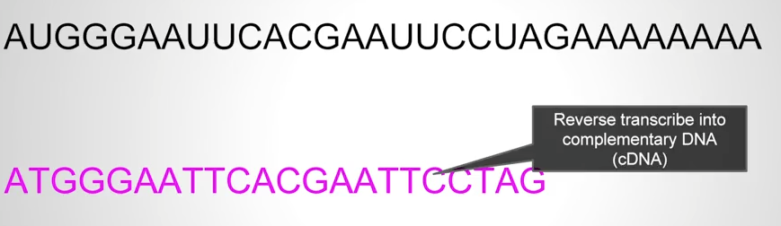
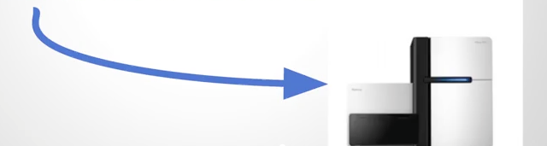
RNA Sequencing
Notes:
And once we've done that, we would have to then, we can't sequence RNA. We have to turn it into DNA. So fortunately we have a very, a very useful molecular mechanism, invented by evolution that, that does reverse transcription. So, there's, there's, the number of virus that do this as their way of, of surviving. So we have reverse transcriptase, and there's a number of different reverse transcriptase molecules we can use that will take RNA and copy it back into DNA. So rather than going from DNA to RNA, you can actually go from RNA to DNA using this special molecule called reverse transcriptase, and that gives us the DNA that matches the RNA that, that is that we've just captured.
Once we have DNA, we just sequence it. And from then, from that point on, it's a, it's a computational problem to figure out which cells, or which genes would turn on those cells. A very complicated computational problem, but it's important in trying to solve that problem that you realize where this data came from.

Slide 23
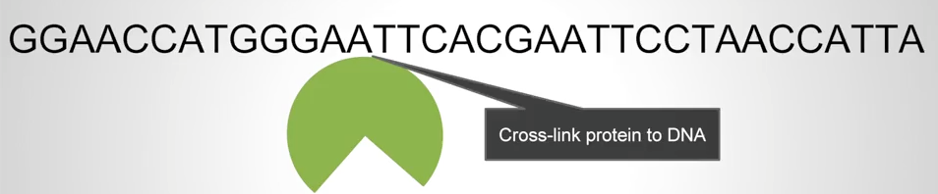
ChIP-seq
Notes:
A third technology that's become very popular through since Next Generation Sequencing Technology was introduced is ChIP-Seq. So ChIP-Seq is trying to address a different problem. Which is trying, which is the problem of understanding where on the DNA certain proteins might bind. Now the way that DNA controls gene expression, the way that our cells control gene expression so that cells can behave differently from one another, is that some genes are, are inhibited in certain cell types or or enhanced in certain cell types. And the way that happens is that you have transcription factors that is other genes themselves, proteins themselves, that bind to the DNA and control the expression of the genes that are near the place where the protein is binding. And we'd like to know where that's happening .
Now of course we don't have today, microscopes that'll let us just look at the, at the chromosome and see where there are proteins bound to it, but we can do something indirect, again, using sequencing. We can, we can, link the proteins, basically freeze the protein right onto the DNA through a process called cross-linking. So we can take a set of cells that we're interested in, a particular cell type. We can cross-link the proteins to the DNA in those cells, so now the protein is basically stuck there. We want to know okay well where was it stuck?

Slide 24
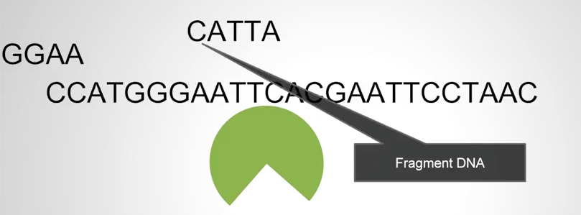
ChIP-seq
Notes:
So what we can do is we can then take that DNA where the proteins are stuck, we can fragment it lots, millions and millions of fragments. Most of them do not have any protein stuck to them, but some of them these are sharp fragments, will have protein stuck to them.

Slide 25
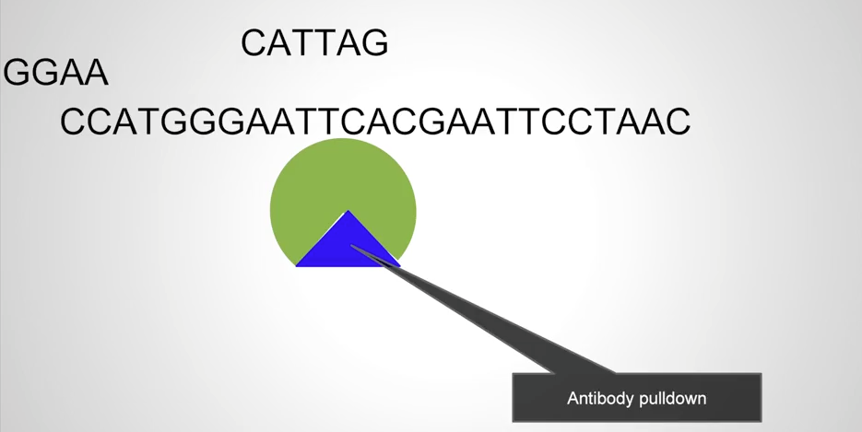
ChIP-seq
Notes:
We can then grab these proteins, we've, we've, we've designed in ChIP-Seq we've designed antibodies that will, that will pull those proteins out of the mixture. So it can pull those proteins out.

Slide 26
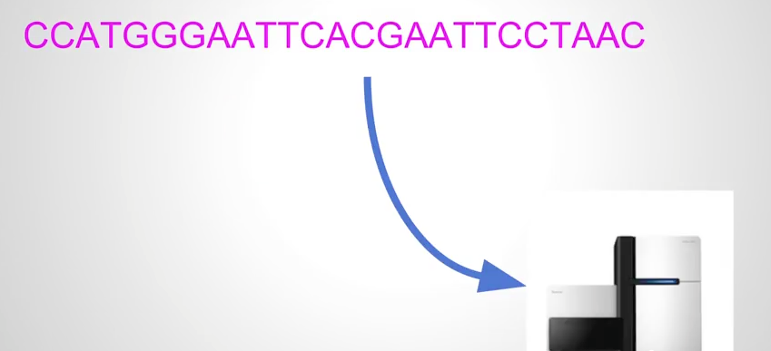
ChIP-seq
Notes:
And when we pull them out, because they're frozen to the DNA we'll pull out these little fragments of DNA that those proteins were bound to at the same time. We can then remove the protein and sequence the DNA.
And again, we've turned, now we've turned our problem into a sequencing problem. The sequences that come out are short fragments and we know because of the way we do the experiment that those fragments were protein binding sites for whatever we were, we were targeting with that antibody.

Slide 27
Ribosome Profiling
Measure how many ribosomes are bound to the mRNA
Brainstorm how to do this…

Slide 28
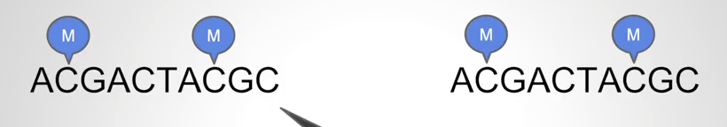

Methelsync
Notes:
one more technique which is called bisulfate sequencing or methelsync. This is a way of determining where on the, the genome the DNA has been methylated.
So methylation is this important epigenetic modification that also affects which proteins are, are being expressed in the cell. And this methylation, methylation marks, or methyl groups, can be passed on from one cell cycle to another as cells divide. So how do we figure out where the DNA was methylated? Well, one way to do this experiment is to split your DNA into two identical samples. You take two very small samples, or aliquots of DNA.

Slide 29
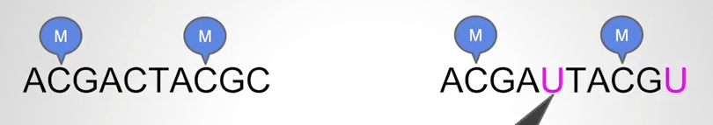

Methelsync
Notes:
Methyl groups are always attached to C’s. then you treat one of them in a special way, doing something called bisulfite conversion. And this biochemical process converts all of the C's that are not methylated to U's.

Slide 30
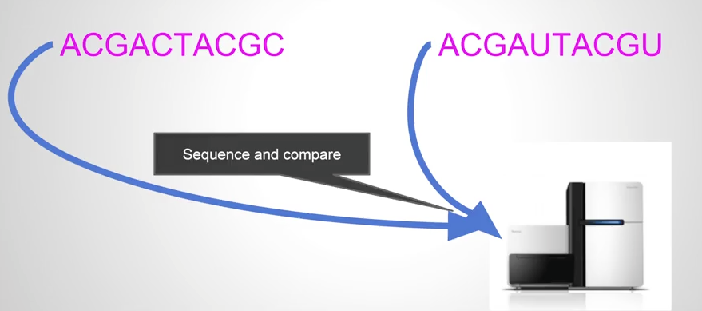
Methelsync
Notes:
So this process now gives us, so now we have two identical samples, where we've converted in one sample, we've converted the, the, the DNA in a special way, so that many of the C's are now U's. And then, we sequence again, and we have to compare those

Slide 31
Alignment
How do we know where DNA sequences that have been sequenced go in the genome?

Slide 32
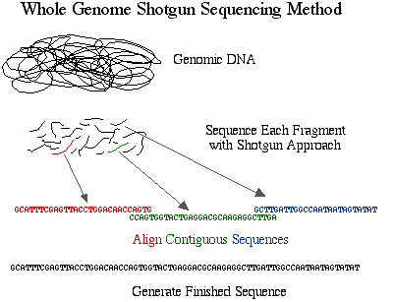
Shotgun Sequencing
Fragment up the DNA
Observe random reads
Try to solve the puzzle!

Slide 33
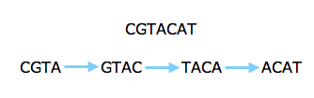

Slide 34
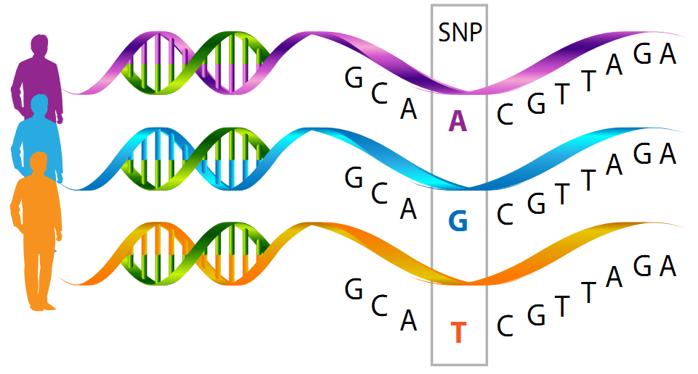
SNPs –single nucleotide polymorphisms

